Slide 1

Microsoft Azure Immersion Workshop: .NET App Modernization
Unlock cost savings and innovation with Azure and .NET Core

Slide 2
Agenda
9:30 – 10:20 Presentation
10:30 – 11:20 Whiteboard design session
12:15 – 13:15 Hands-on lab
13:30 – 15:00 Hands-on lab

Slide 3
Digital transformation
The question is no longer “if or when”, it’s “how”
Digital transformation is an economic imperative
90% of organizations will use an integrated IaaS and PaaS provider by 2022¹
The cloud is the safest place for your business
Benefits of the cloud are proven
¹ Gartner
Notes:
Companies are being forced to transform themselves and that trend is only accelerating as “physical first” business models are being tested and digital channels being strained as customer and employees are being asked to engage with brands and businesses remotely.
Those that make the transformation survive, as it is of economic imperative to do so. For many, that transformation begins with .NET and SQL which have been the foundation of modern web experiences for over twenty years
https://www.gartner.com/en/newsroom/press-releases/2018-09-12-gartner-forecasts-worldwide-public-cloud-revenue-to-grow-17-percent-in-2019
https://azure.microsoft.com/en-us/overview/security/
https://azure.microsoft.com/en-us/overview/trusted-cloud/ - Azure invests over $1B USD in security R&D, and analyzes 6.5 trillion threat signals daily

Slide 4

What is driving cloud adoption?
Infrastructure oriented drivers
App oriented modernization drivers
Urgent capacity needs
Software & hardware refresh
Quickly integrate acquisitions
Compliance and security threats
Software end of support
Cost savings
Datacenter contract expiry
Application innovation
Migration and innovation triggers
Notes:
While the drivers of modernization vary, increasingly CIOs are looking to
Quickly scale applications and databases experiencing demand and usage spikes
Prioritize new features based on urgent user need – what are the critical capabilities needed today?
Focus their IT staff on urgent, priority tasks (not maintenance)
Rationalize CAPEX for private datacenter investment and optimize their application and data estate
Rethink the way they develop apps to reflect new/altered realities “how will we need to do business now”

Slide 5




Why modernize with Azure?
Peerless Innovation
25+ years of SQL innovation
The only managed app hosting platform for .NET
Native Visual Studio integrations for live-site debugging
Two decades of investment
Unmatched Experience
Shared code base ensures full parity with SQL Server
Industry leading performance and security for 9T queries daily¹
Host 2M apps and 41B daily requests with 99.95% SLA²
Globally managed offerings
Seamless Migration
Support & funding from Azure Migration and Modernization Program
Free App and Database Migration & Containerization Assistants
.NET 5 Upgrade Assistant
Tailored tools and programs
Unbeatable Offers
Use SQL licenses and save 59% vs. AWS with Azure Hybrid Benefit
Visual Studio subscribers save up to 55% off PAYG rates with Enterprise Dev/Test for non-production workloads
Reserved Instances offer up to 55% saving for production workloads
Unique for .NET and SQL
Notes:
Microsoft is the trusted partner that can help modernize applications and data and drive cost savings without time consuming and expensive rework and code changes..
We’ve been the stewards of .NET, SQL and Visual Studio for over two decades, improving those products and building a fully managed and optimized home in Azure for the apps that depend on them.
We built our managed services are built on IIS and the SQL code base, and offer 99.95%+ SLAs on millions of .NET apps, billions of request and trillions of SQL queries every day.
We’ve custom built migration assistants to assess your applications, databases and even your .net code and migrate workloads seamlessly to our managed services, containerize them with Windows Containers and even update the code to modern frameworks like .NET 5.
We can provide additional support and subsidies for large projects through our Azure Migration & Modernization Program
And we’ve tailored offers for Microsoft customers looking to get started with Azure – our Azure Hybrid Benefit and Enterprise Dev/Test offers help you maximize the investment in your existing on-premise SQL and VS licenses and new commitment discounts through reserved instances offer savings up to 55% for production workloads.
¹ All Claims as of 2/20/2019.
http://www.tpc.org/4081; http://www.tpc.org/3331; http://www.tpc.org/3329; http://www.tpc.org/3321; National Institute of Standards and Technology Comprehensive Vulnerability Database
** Data sets derived from industry-recognized TPC-E Benchmark™. Simulated 400 concurrent users, unlimited pacing, 8 deg of parallelism, 5 test runs. Results above were for Premium SSD storage on Windows Server. Similar tests run for Red Hat Enterprise Linux and for high-end storage.
https://gigaom.com/report/sql-transaction-processing-price-performance-testing-azure-eas-vs-aws-r5a/
² This SLA refers to Azure App Service

Slide 6













ASP.NET modernization patterns
Application Stack—Sample Scenario
Modernization Objectives
Platform
Apps
Data
Greater cloud efficiency (resources, speed, cost, managed operations).
Meet scalability needs with minimal changes.
Leveraging existing dev investments.
Academy Awards migrated their .NET Framework-based member portal to App Service & Azure SQL
ACR:
.NET Framework 4.x web apps
.NET
App Service
ASP.NET
Azure SQL
Modern development at scale.
Better performance, less compute.
Lower costs with Linux.
Easier adoption of new cloud capabilities.
Optimizely EpiServer upgraded their web application portfolio to .NET 5 to take advantage of cost savings running on Linux in Azure
.NET 5+ web apps
.NET
App Service
ASP.NET Core
Azure SQL
Fully managed microservice experience.
Application scale and agility.
Increase efficiency.
Mix of technology stacks.
Siemens Healthineers moves more computing to the cloud with highly scalable .NET microservices and AKS
.NET 5+ microservices
.NET
AKS
ASP.NET Core
Multiple DB
Multi framework / multi-DB apps
Accelerating innovation with technology of choice.
Building applications faster.
Reducing operational cost.
Ease of integration with web and cloud apps.
Premera modernized their patient portal with Azure managed services
App Service/AKS
Multiple Frameworks
Multiple DB
Notes:
There are a number of ways to modernize your infrastructure and code with Azure
The primary pattern for ASP.NET Framework applications running either as code or in a Windows Container is with App Service and Azure SQL
Many customers are modernizing their .NET code as they move to the cloud as well and with new support for .NET 5 on App Service, customers can get the flexibility and scalability of .NET Core with the manageability of App Service.
.NET 5 is also being used to refactor monoliths as microservices and AKS has become a mainstream modernization destination for many applications. This is one of the primary reasons we added coverage for AKS in the Azure Migration Program in 2021.
Finally seeing .NET being used in conjunction with other frameworks – notably node and python – modernization doesn’t just mean bringing existing code to run on Azure, can modernize the code along the way and also extend the app using multiple frameworks.
Of all these patterns however, the area where Azure is most differentiated is with App Service and Azure SQL.

Slide 7
Azure is the home in the cloud for your .NET applications
Azure offers the only end-to-end web hosting platform designed from the ground up to build and manage .NET applications
Unmatched productivity
App Service and Azure SQL Database are optimized to be the home in the cloud for .NET web apps and their databases
Fully-managed offerings
Azure Migrate and our free app and database migration assistants provide a simple path to the cloud
Seamless migration
Notes:
For IT leaders who need to reduce the cost of managing their .NET web applications and the SQL databases that power them, Azure offers the only end to end web hosting platform designed from the ground up to build and manage .NET applications. Leveraging our deep expertise in Windows, Visual Studio and ASP.NET, we designed App Service and Azure SQL DB as the home in the cloud for .NET application and the databases that power them.
Simply put, there is no better place to build, host, and manage your .NET applications. Azure App Service—along with Visual Studio family of tools—provides unmatched developer productivity for development, live-site debugging, and zero downtime through deployment slots.
For ASP.NET apps in particular, Azure has unmatched offers like Azure Hybrid Benefit and Enterprise Dev/Test that significantly reduce the cost of running these workloads on the only fully managed PaaS environment that natively supports Windows. Rather than provide SDKs and plug-ins, we’ve built natively on IIS, integrated Visual Studio directly into the platform to make and ship code changes in real time, and created our managed SQL platform on the same code base as SQL Server.
Azure’s been building, managing and improving these services for 25+ years. We run 2M sites, 40B+ requests and over 9T SQL queries every day with the 99.95% SLA or higher. We are better than AWS in end-to-end developer experience, better than GCP in providing native Windows support, and better than Heroku in supporting enterprise use cases.
And with our free migration assistants it has never been easier to get started.
Let’s take a closer look at how migrating to Azure can help elevate your business.
<click>

Slide 8
With App Service and Azure SQL you can
Optimize Cost
Operate Confidently
Ship New Features Faster
Reduce costs and optimize spend to support changing business priorities
Seamlessly scale web apps and databases by migrating to fully managed services with built in auto-scaling
Adjust to new realities and ship new features faster to meet the changing needs of users
Notes:
Like we just talked about, Azure was built for .NET, and our cloud services have been fine-tuned over the past decade to run these workloads.
By letting Azure take care of availability, security, and infrastructure management, you optimize your resources and spend by a leveraging a platform that runs over millions of .NET apps and trillions of SQL queries every day.
This leaves you free to focus time and resources on serving your customers, users and employees. Bringing your .NET apps to Azure also enables them to seamlessly scale to handle unprecedented demand and enables the agility required to navigate uncertainty. Lastly, with our native integrations with Visual Studio and GitHub, developers will have unparalleled freedom to make and ship changes and add the critical capabilities your customers are looking for.
T: Let’s take a closer look. <click>

Slide 9

Optimize Costs
© Microsoft Corporation
Azure
Notes:
Let’s start with how migrating .NET applications to Azure can help improve your business’s cash flow.
<click>

Slide 10
Today’s imperative: balance near term savings with future growth
IT leaders must plan for an uncertain future…
…while rationalizing near term costs
Shifting compliance requirements
Executive leaders [in times of recession] turn to “quick wins”, and ad hoc cost cutting. While theses decisions can save money in the short term, they can inhibit the function’s long-term strategy to come out of a tough economic environment. Gartner
Server overhead management
Network utilization and availability
Enterprise leaders face unprecedented budget pressure […] but that urgency only increases the need to assess all cost decisions strategically. Gartner
Database, OS and runtime patching, updates and backup
While CIOs and their business partners are under intense pressure to cut tech budgets, technology plays a vital role in business survival and success during this recession. Forrester
Application management and resource usage
Dev/Test and staging environment costs
Notes:
Among the many challenges CFOs face in volatile times, one of the most significant is increasing working capital to ensure cash is available for operating expenditures.
However, it is critical to reduce costs now without negatively impacting your long-term growth. While there may not be priorities in the current climate for long term investment, migrating your .NET apps to Azure can play a key role in addressing both cutting costs and investing in your future.
Furthermore, moving to the cloud allows a company to shift its expense base from upfront capital expenditures (capex) to operating expenditures (opex) that are spread out, which conserves cash flow freeing it up for other initiatives.
<click>

Slide 11



Businesses must balance near-term savings with future growth
CFOs Look to Boost Cash Holdings, Cut Costs Amid Coronavirus Outbreak
Finance chiefs are boosting cash holdings, slashing costs and collecting outstanding payments to ensure their companies remain sufficiently capitalized to withstand financial hits from the coronavirus epidemic.
Companies across sectors are exposed to outbreak-related losses and challenges, including in the manufacturing, retail and travel industries amid factory closures, travel restrictions and changes in consumer behavior.
As Virus Hobbles Economy, Companies Race to Tap Credit and Raise Cash
In a single week in March, as financial markets convulsed and major parts of the economy began shutting down, banks made over $240 billion in new loans to companies — twice as much in new lending as they would ordinarily extend in a full year.
Gartner Says COVID-19 Related Cost Cuts Could Damage Long-Term Growth Prospects for CFOs
CFO Success in Navigating Previous Crises Started with Differentiated View of Cost Management
CFOs resorting to short-term and unsustainable cost cutting measures during the COVID-19 pandemic risk missing the opportunity to fundamentally reshape their competitive standing over the long-term, according to Gartner, Inc.
Extensive long-term research into the performance of 1,142 global public companies revealed that organizations able to navigate downturns with industry-leading performance in both cost containment and top-line growth followed a differentiated set of behaviors with regards to managing costs and investments that set them apart from their lower performing peers.
Notes:
Among the many challenges CFOs face from the COVID-19 pandemic, one of the most significant is increasing working capital to ensure cash is available for operating expenditures.
Given that many industries are experiencing significant volatility in revenue and expenses, cash is king. There is intense scrutiny on capital expenditure budgets, which is the key line item for building and expanding a company’s private data center.
However, it is critical to reduce costs now without negatively impacting your long-term growth. While long term investment may not be the priority of organizations in the current climate, migrating your .NET apps to Azure can play a key role in addressing both cutting costs and investment in your future.
Furthermore, moving to the cloud allows a company to shift its expense base from upfront capital expenditures (capex) to operating expenditures (opex) that are spread out, which conserves cash flow freeing it up for other initiatives.
<click>

Slide 12
How Azure can help (1 of 3)
How Azure can help (1 of 3)
Azure manages your applications and databases so you don’t have to
Built-in intelligence optimizes resources and reduces spend
Get more cloud for less
With leading SQL price-performance and savings up to 85% off pay-as-you-go rates with Azure Hybrid Benefit and save up to 49% with Enterprise Dev/Test
End-to-end hosting platform and evergreen SQL free up teams to focus on what matters most
Sense and surface opportunities to save with out-of-the-box monitoring for ASP.NET applications and AI-powered SQL optimization
Notes:
A .NET app approach on Azure allows you to reduce costs and realize the full value of your teams and your web applications.
Allow your teams to focus on what matters most by offloading management of your apps and data to Azure. Azure offers an end to end hosting platform, fine-tuned to run .NET apps powered by evergreen SQL, which never needs to be patched or updated and is always running the latest version.
Leverage the power of built-in intelligence capabilities that surface opportunities for you to save. An example of this is out of the box monitoring for ASP.NET applications and AI-powered SQL optimizations.
Get more cloud for less with Azure Hybrid Benefit—savings can amount up to 85% off with pay as you go rates.
[Speaker guidance: Click on icons to view L200 drill down slide for more detailed proof points if the customer shows a particular interest in one area.]
T: So what other benefits can you expect? <click>

Slide 13
What can you expect?
Save on data and infrastructure
Optimize technical teams
Drive long-term returns
Up to 54%
50% Increase
414%
in database admin and developer efficiency and team velocity^{2,3}
3-year return on investment with Azure Managed Services²
Save up to 54% versus on premises and 30% compared to AWS¹
(1) Costs and Benefits of .NET Application Migration to the Cloud – a commissioned study conducted by GigaOm, November 2020
(2) The Total Economic Impact™ Of Microsoft Azure Serverless —a commissioned study conducted by Forrester Consulting, July 2019
(3) The Total Economic Impact™ of Migration to Microsoft Azure SQL Managed Databases — a commissioned study conducted by Forrester Consulting in March 2020 on behalf of Microsoft
Notes:
The value that can be realized through .NET app migration to Azure is not trivial.
Take advantage of Azure offers that ease the burden of migration and experimentation. Qualify for discounted rates to support your ongoing development and testing on Azure. Customers can expect to save up to 49% on data and infrastructure with the Enterprise Dev/Test offer.
Additionally, developers and database admins see up to a 50% increase in efficiency and team velocity and companies can realize up to a 414% 3-year ROI with Azure Managed Services.
T: Let’s take a look at how a Microsoft customer has optimized costs on Azure. <click>
https://azure.microsoft.com/en-us/resources/forrester-tei-azure-serverless/

Slide 14
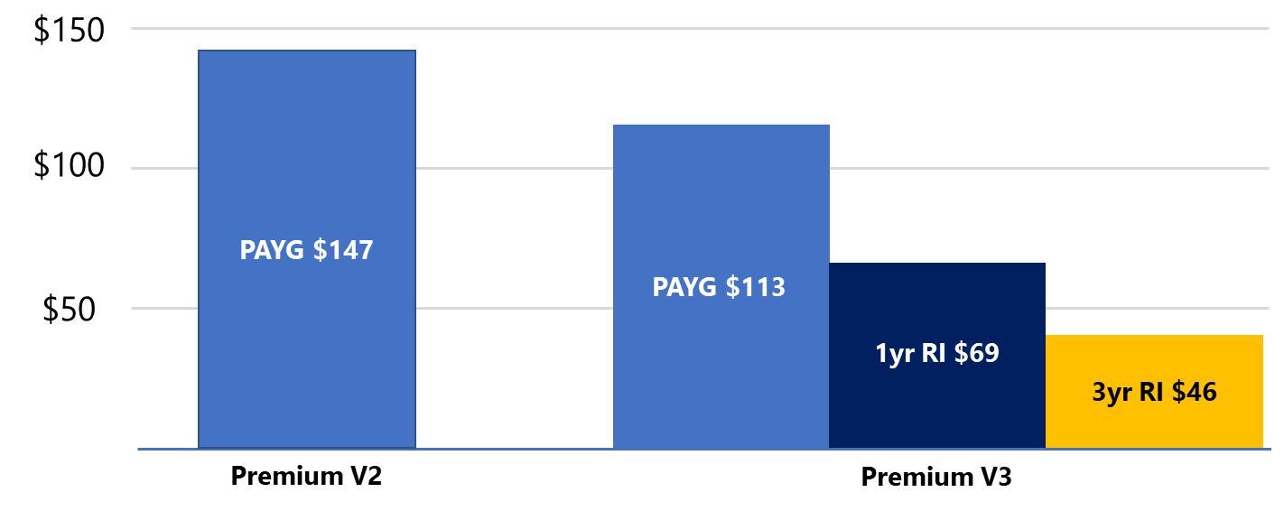
Improving App Service Price to Performance: Premium v3 with Windows Container GA
App Service Premium Monthly Cost*
*Comparison of P2v2 (Dv2 – 2vCPU, 7GB) vs P1v3 (Dv4, 2vCPU, 8 GB) for App Service Linux, US East Prices RI pricing available 11/1/20
GA Windows Container and Hyper V-virtualization
Supports COM+ and custom OS dependencies
New memory size options up to 32GB support enterprise apps/CMS requirements
Reduced PAYG rates, new Dev/Test offer for non-production workloads and deep discounts available through Reserved Instances
Notes:
At Ignite we invested heavily in our platform to improve both price and performance
App Service Premium (V3) Plan which leverages the latest Azure VM hardware to deliver improved performance and better scalability. This offering includes more powerful 2,4, and 8 vCcore options with memory stretching up to 32 gigs to better support large, enterprise web applications. Offered at a 20% discount vs. comparable PV2 configurations this is our most performant and cost competitive offering to date.
One of the most important new capabilities in Premiumv3 is the long awaited GA of Windows Containers support which is available in more regions and updated with full support for regional network integration, Private Link and Managed Server Identity. Starting October 1, customers can lift and shift a wide variety of .NET framework applications, including those using COM+ and those with OS dependencies and take advantage of the fully managed features of App Service.
This plan is roughly 20% cheaper than PAYG rates for Pv2 and we’ve introduced new Dev/Test rates for non-production workloads (around 40% off PAYG) and also introduced new Reserved Instance pricing for production workloads offering savings up to 55% for a three year commitment.

Slide 15


Premera Blue Cross migrates to the cloud to deliver premium customer service, reduce costs
Read the full story
Premera used Azure to increase customer convenience and improve website performance
App Service was used to power the site and act as service tier for crucial user interfaces—from choosing a provider to checking on a claim
Premera dramatically reduced infrastructure costs, and its developers are preventing problems before they occur with proactive diagnostics
“We needed to redesign Premera.com to create a unified, seamless experience for our customers. So, we chose Azure.”
—Tom Craig, Senior Cloud Engineer
Notes:
Here we see how Premera migrated their website to the cloud and realized to their bottom line.
When not-for-profit health plan company Premera Blue Cross decided to increase customer convenience and amp up its website performance, it embraced the cloud. The company sought a highly reliable, highly secure solution for its customers.
Premera turned to Microsoft Azure, especially Azure App Service, which forms the service tier for its crucial user interface and other services. The company uses App Service diagnostics to guide its self-troubleshooting experience—reactively and proactively.
The company is rapidly reducing infrastructure costs, and its developers are preventing problems before they occur with the proactive diagnostics. That means lower costs, higher customer satisfaction, and an effective team.
<click>

Slide 16

Operate Confidently
Notes:
In addition to improving cash flow, let’s examine how migration of your .NET applications to Azure will allow them to scale to meet any fluctuations in demand.
<click>

Slide 17
The ability to scale web applications is critical
IT leaders must be prepared for spikes in traffic…
…but scaling can be complex
Physical resource limitations
During previous holidays, we had site scalability issues that made it difficult for us to meet the levels of customer service that we expect from ourselves…with Azure, we were able to cope with more sessions and more online customers than we’d ever seen.
Kevin Diamond, head of global E-commerce, Forever 21
Adaptation to changing requirements
Memory management issues
Last year we depended on adding physical hardware way ahead of and event [black Friday], adding cost and complexity. This year, we saw more than 500 views a second and delivered 21 TB of data to our customers, with great response times.
Thomas Wilhelmsen: Head of IT Operations, Klompett
Backup and database restore difficulties
Database engine efficiency
Server configuration optimization
Notes:
With more people working, connecting, and shopping online demands on your applications are at an all time high.
The ability to quickly scale your apps to meet this increased demand is critical to meeting the needs of your customers, however scaling your web apps to meet changes in demand isn’t always simple.
IT leaders need to consider and prioritize a host of various issues:
Physical resource limitations
Adaptation to changing requirements
Memory management issues
Backup and database restore difficulties
Database engine efficiency
Server configuration optimization
With a .NET app approach on Azure, you can be confident that your web apps will be able to scale to handle any increase in traffic. Let’s take a look at how.
<click>

Slide 18



IT leaders must be prepared for spikes in traffic
CIOs should prepare IT systems now to safely and reliably handle a vast increase in remote workers and digital fulfillment of market demand.
— Laura Starita, Gartner
COVID-19 Pushes Up Internet Use 70% And Streaming More Than 12%, First Figures Reveal
The first internet streaming and usage figures are coming in as the coronavirus pandemic places a quarter of the world’s population under lockdown. As millions of people go online for entertainment and more, total internet hits have surged by between 50% and 70%, according to preliminary statistics. Streaming has also jumped by at least 12%, estimates show.
While an increase is not surprising with so many people ordered to stay at home, streaming of many planned sporting and musical events is impossible as they are cancelled.
Washington state unemployment website crashes after ‘a tsunami of claims’ for coronavirus job-loss benefits
Instead of unemployment benefits, out-of-work Washingtonians say they are getting frustration and delay from the state’s web site for COVID-19 job-loss benefits.
Washington was one of the first states to roll out unemployment assistance backed with federal cash under several new assistance programs for people unemployed because of COVID-19, the illness caused by the novel coronavirus. The aid goes beyond unemployment benefits in several ways.
Coronavirus transforms peak internet usage into the new normal
Cities throughout the US have emptied out amid the coronavirus outbreak. Millions of people are working from home, children are attending school remotely, and no one's heading to ballparks, nightclubs or movie theaters. They've all turned to their home broadband connections to stay connected.
Notes:
With more people working, connecting, and shopping online, demands on your applications are at an all time high, and global pandemic has only accelerated this uptick. With websites being, in some cases, the only way to interact with customers, it’s more imperative than ever that they be available and reliable when you customers visit them.
The ability to quickly scale your apps to meet this increased demand is critical to meeting the needs of your customers. With a .NET app approach on Azure, you can be confident that your web apps will be able to scale to handle any increase in traffic—in times of disruption and beyond.
<click>

Slide 19
How Azure can help (2 of 3)
Right-size your infrastructure and increase availability
Get up to speed quickly on a platform tailored for .NET
Secure your applications and databases
Ensure zero-down-time deployments using an enterprise-grade web hosting platform that serves over 2M sites and processes 41B requests and 9T SQL queries per day
Designed product and interface to be familiar from day one for .NET developers and SQL DBAs
Protect your applications and improve security posture with built-in web app and database security controls
Notes:
Azure can help to scale .NET applications in three key areas
An enterprise grade web hosting platform allows business to easily right-size infrastructure to meet demand. Power your app on an enterprise grade web hosting platform that serves over 2 million sites and processes 41 billion requests and 9 trillion SQL queries per day
In terms of efficiency, with PaaS services built for SQL and .NET you can be sure that you can build with confidence from day 1.
And in terms of security, Azure Security Center will improve your security posture and threat protection with extensive compliance certifications.
[Speaker guidance: Click on icons to view L200 drill down slide for more detailed proof points if the customer shows a particular interest in one area.]
T: Let’s take a look at how a Microsoft customer has scaled on Azure. <click>

Slide 20


Retail leader Komplett focuses on customer satisfaction with full landscape migration
Read the full story
Komplett’s legacy e-commerce platform was expensive to maintain and difficult to scale
The company migrated the entire platform to Azure in 5 months
They can now scale on demand with managed PaaS tools and focus on innovative features and services, not routine maintenance and operations .
“The biggest difference this year was ease of scalability. Last year we depended on adding physical hardware way ahead of the event, adding cost and complexity. This year, we saw more than 500 views a second and delivered 21 TB of data to our customers, with great response times. Using Azure, we were easily able to scale on demand to get the performance we needed.”
- Thomas Wilhelmsen: Head of IT Operations
Notes:
Microsoft customers in myriad industries are realizing the benefits of simple scalability that comes from migrating their Apps to Azure.
Komplett relied on on-premises datacenters to operate and fulfill a complex e-commerce operation a platform that was not only expensive and time-consuming to maintain, but also limited in its ability to scale up at speed. The company adopted a cloud-first strategy to enhance flexibility and reduce costs
Within five months Komplet had migrated nearly its entire web platform to Azure, removing the complexity of virtual machines and going straight to Azure App Service environments.
Whereas in the past Komplett had to depend on adding physical hardware to scale for demand, they are now able to easily scale as necessary to get the performance they need by using flexible platform as a service (PaaS) offerings in Azure. Additionally, moving to Azure has given the development team the opportunity to focus on creating innovative features and services rather than performing routine maintenance and operations.
<click>

Slide 21

Ship New Features Faster
Notes:
Lastly we take a look at the need to adjust to new realities and meet the pressing needs of customers and employees with agility and innovate purposefully to prepare for the future.
<click>

Slide 22
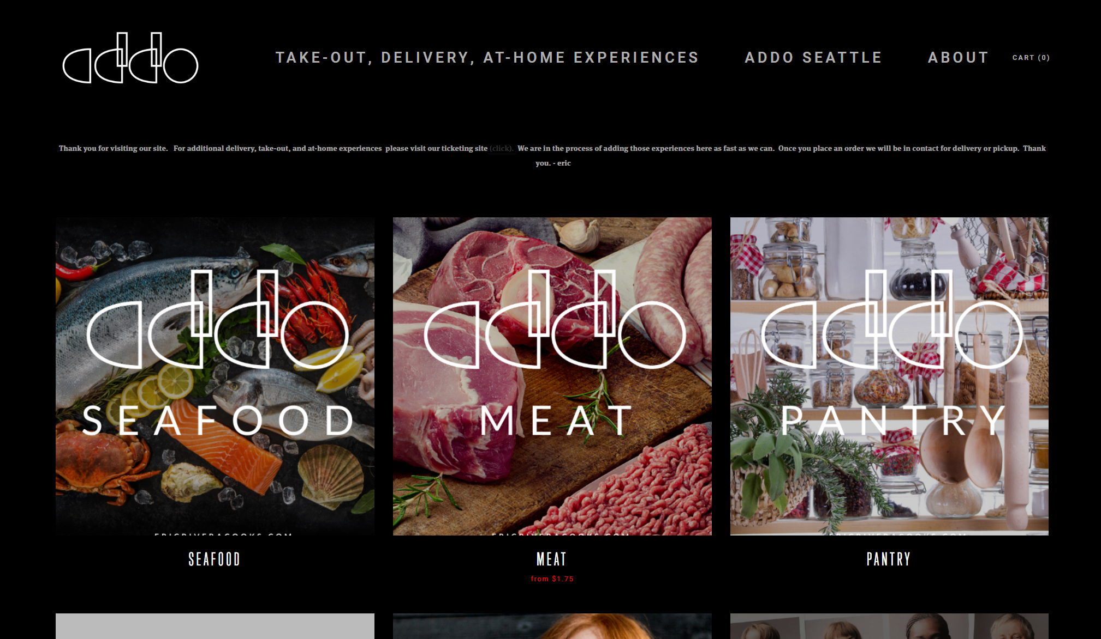
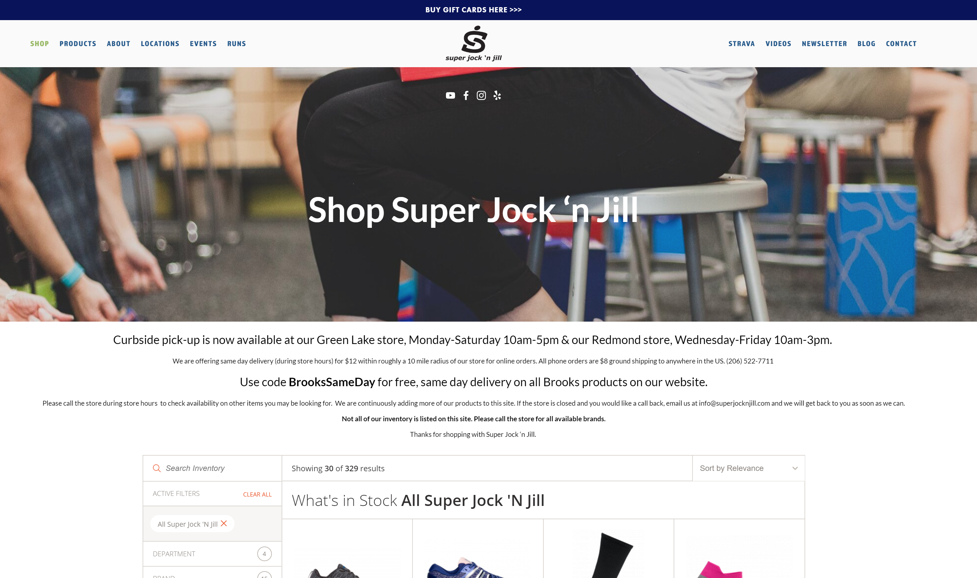
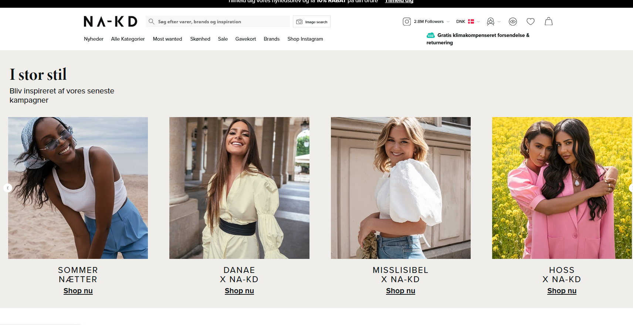
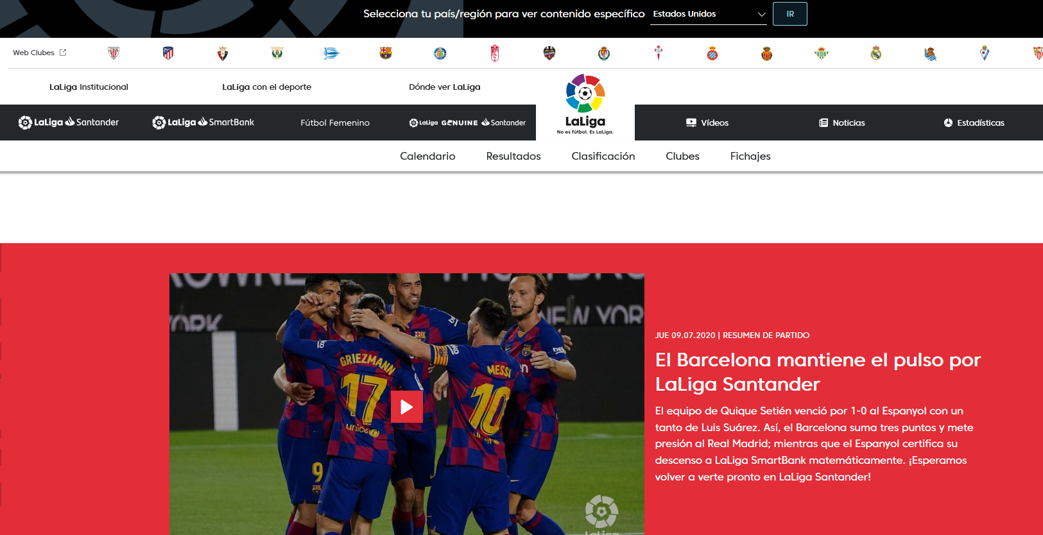
Digital demand for information, goods, and services has never been higher
Businesses across industries must quickly shift from “physical-first” to “digital-first” engagement strategies
Notes:
The present climate has created increased impetus for business to diversify the ways they interact with customers, and websites play a central role in these initiatives. From restaurants building out menus and delivery options, to grocery and other retail stores refining and updating their in-store, pickup, and delivery shopping experiences, to doctors connecting with their patients virtually, the demand on web application functionality has never been greater and CIOs are looking to rapidly ship critical new features to meet fast changing user needs.
<click>

Slide 23
How Azure can help (3 of 3)
Stand up critical capabilities
Extend applications to interact with any system and evolve quickly
Innovate with confidence
Native Visual Studio integration offers unparalleled developer productivity so you can ship new features faster and maximize value per dev cycle
Add new modalities and connect your app to the data and systems it needs to serve users
Adjust to new realities and pivot to meet new requirements on a trusted cloud platform
Notes:
A .NET app approach on Azure enables you to stand up critical capabilities quickly and with confidence, so you can meet any demand as it comes up.
Migration of your .NET applications to Azure allows developers to publish code changes directly to app service quickly responding to changing user needs.
Developers can also quickly test and deploy these capabilities and connect them to new data sources thereby extending applications to interact with any system.
Your dev team will also be able to work and innovate knowing that they are benefitting from comprehensive web application security.
[Speaker guidance: Click on icons to view L200 drill down slide for more detailed proof points if the customer shows a particular interest in one area.]
T: So let’s see standing up critical capabilities in action. <click>

Slide 24


The Academy powers the Oscars with App Service and Azure SQL
Read the full story
Needed to expand its member portal, improve scalability and introduce a new mobile app for Academy members to stream nominated films
Migrated existing .NET apps to App Service and Azure SQL
Used Visual Studio and Azure DevOps to iterate and ship cross-platform mobile app using Xamarin
Academy members streamed over 850 titles across 24 categories ahead of the 92nd Oscars with zero downtime.
“Nobody understands .NET and SQL Server better than Microsoft, which, through Azure, gave us a robust set of managed services for migrating our legacy applications to the cloud.”
— Bev Kite, CIO Academy of Motion Picture Arts and Sciences

Slide 25

Unlock innovation with .NET Core

Slide 26

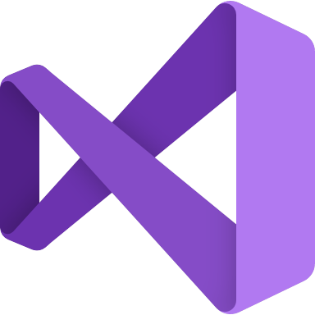



.NET 5 brings together all our innovation
TOOLS
DESKTOP
WEB
CLOUD
MOBILE
GAMING
IoT
AI
WPF
Windows Forms
UWP
ASP.NET
Azure
Xamarin
Unity
ARM32
ARM64
ML.NET
.NET for Apache Spark
VISUAL STUDIO
VISUAL STUDIO FOR MAC
.NET 5
VISUAL STUDIO CODE
INFRASTRUCTURE
RUNTIME COMPONENTS
COMPILERS
LANGUAGES
CLI
Notes:
You can build anything with .NET.
We’ve made significant investments in .NET over the years as well as unifying the ecosystem to support building literally anything. From desktop to gaming to the cloud, .NET is a general purpose programming platform that enables all kinds of application scenarios. Once you learn one, you can easily pick up another.
.NET is a unified platform with shared libraries, runtime components and languages. It also has a set of best-in-class tools with Visual Studio, Visual Studio for Mac and the cross-platform editor Visual Studio Code.

Slide 27
.NET ecosystem is seeing tremendous momentum
>5M
#1
Top 30
Most Loved Framework (2019 & 2020)
.NET Core
Highest velocity OSS projects github.com/dotnet
.NET developers
In Visual Studio family
Top 5
>10X
>40%
Language on GitHub
C#
Faster than Node.js
ASP.NET Core
New to .NET are students
dot.net download survey
Sources: insights.stackoverflow.com/survey/2019#most-loved-dreaded-and-wanted & insights.stackoverflow.com/survey/2020#most-loved-dreaded-and-wanted github.com/cncf/velocity/ octoverse.github.com/ https://www.techempower.com/benchmarks/#section=data-r20&hw=ph&test=plaintext
Notes:
We are seeing significant growth in the .NET ecosystem:
There are 5 million monthly active developers in Visual Studio family of tools.
.NET Core has been ranked #1 two years in a row as the most loved framework on StackOverflow developer survey.
Cloud Native Computing Foundation (CNCF) tracks the highest velocity projects on all of GitHub which they measure by the rate at which pull requests and issues come in & how many are accepted, and dotnet projects are consistently in in the top 30 since 2017. dotnet ranks # 1 in most active in 2021.
Speaking of GitHub, C# is in the top 5 languages, an indicator of a healthy open source ecosystem.
And the .NET contributors are extremely proud of their work on performance. ASP.NET Core ranks #1 web framework in the TechEmpower benchmarks, an independent, open source set of web performance benchmarks that measure dozens of languages and application frameworks, .NET has the fastest web framework on the planet. faster than C++, Java and Go.
Lastly, we continue to see a large part of new users downloading .NET identifying as Students in the download survey, which gets thousands of responses a week indicating a healthy growth trajectory.
All this is possible because of open source collaboration.
Sources:
https://insights.stackoverflow.com/survey/2019#most-loved-dreaded-and-wanted
https://github.com/cncf/velocity/
https://octoverse.github.com/
https://www.techempower.com/benchmarks/#section=data-r20&hw=ph&test=plaintext

Slide 28
Users are adopting .NET 5 for better performance
Java Servlet
.NET
Node.js
>10X faster than Node.js
Faster than Go, C++ and Java
ASP.NET Core web framework
.NET gRPC server performance
https://www.techempower.com/benchmarks/#section=data-r20&hw=ph&test=plaintext
https://github.com/LesnyRumcajs/grpc_bench/wiki/2020-08-11-bench-results
Notes:
Better performance leads to lower compute costs and .NET gets better every release. In the latest Techempower benchmarks .NET 5’s web framework, ASP.NET Core, is over 10 times faster than Node.js and gRPC server performance is faster then Go, C++ and Java.

Slide 29
Why .NET 5?
.NET Framework
Flexible deployment
Unparalleled performance
Reduced infrastructure & hosting costs
Modern, innovative languages and APIs
.NET
.NET Core
Mono / Xamarin
Notes:
Our vision for one .NET is to simplify the platform and choices for .NET developers and provide a single stack that supports the best of breed solutions for all modern workloads and operating systems.
We’ve taken the best of .NET Framework and have added to .NET Core, including many familiar APIs, as well as Windows desktop apps with WPF and WinForms. Now we are unifying all the platform, SDK and tools by bringing in Mono and Xamarin.
.NET Core and .NET 5 can be deployed side-by-side, on Windows, Mac or Linux, with or without containers, allowing you ultimate deployment flexibility.
We continue to make significant performance improvements up and down the stack so that native client apps and cloud web apps perform excellent. As I mentioned earlier .NET 5 now tops the TechEmpower round 20 benchmarks as the fastest web framework on the planet.
Better performance means less compute costs. And flexible deployment options reduces infrastructure and hosting costs particularly when hosting on Linux in Azure.
.NET 5 is the focus of our investments in the .NET platform going forward with modern innovative languages and APIs, which makes it the logical choice for any .NET based application.

Slide 30
Why .NET 5 for web apps & services?
Fastest web framework on the planet*
Flexible deployment with Linux & containers
Smaller image sizes that use less memory
Modern, innovative languages and APIs
OpenAPI, Client generation, APIM support built in
Cross-platform development & debugging with WSL 2
C# full-stack web development & static web apps
.NET
*TechEmpower benchmarks round 20 (published 2/8/2021) https://www.techempower.com/benchmarks/#section=data-r20&hw=ph&test=plaintext&a=2
Notes:
So how do we convince customers to move to .NET 5? Developers tend to want to be working on the latest and greatest. But TDMs also need to be aware that:
As mentioned, we continue to invest in performance up and down the stack and the benefits for web developers are huge. Better performance means less compute needed.
We have also focused on several cloud & web investments, such as smaller, faster, single file applications that use less memory which are appropriate for microservices and containerized applications across operating systems.
We’ve added OpenAPI support in REST/HTTP APIs which make it easy to publish to Azure API Management. You also get automatic client generation for easy testing and debugging.
With Windows Subsystem for Linux we’ve also made it simple to “Develop on Windows for Linux” with debugging via WSL 2 that is included in Visual Studio 2019 16.9 that just released.
.NET 5 also supports full stack C# web development with Blazor, that can run on the server or on the client via WebAssembly. That means you don’t need to use JavaScript anymore to build SPAs and these apps are automatically PWAs.

Slide 31


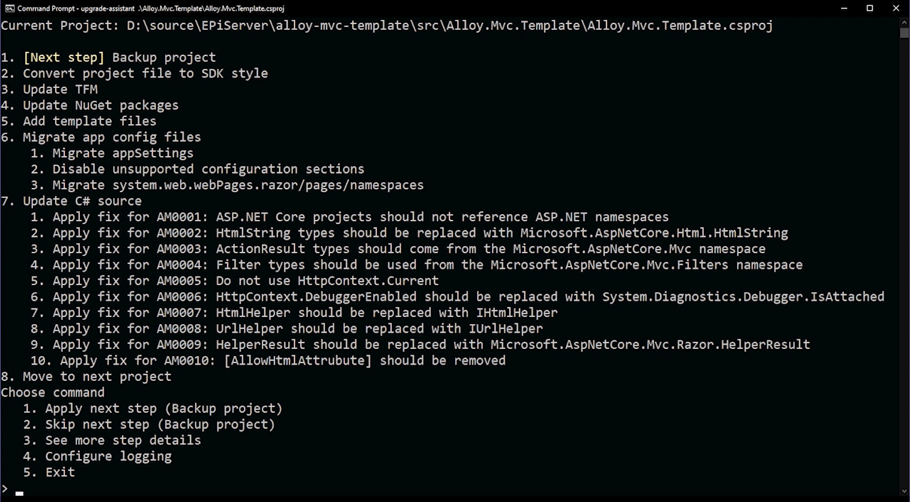
.NET 5 & latest .NET 6 Previews on App Service
NEW!
Deploy .NET 5 apps with Visual Studio and VS Code with full support from GitHub Actions
Day 0 support for latest .NET previews including .NET 6
Learn more |
aka.ms/dotnet_appservice
Notes:
To help developers upgrade, we’re building the .NET Upgrade Assistant that helps you modernize older .NET codebases. It's a command line tool that gives you step-by-step instructions for upgrading to the latest versions of .NET.
Analyze NuGet packages and understand where your dependencies are.
It gives you recommendations and fixes for project files, configuration, and source code to help you incrementally upgrade at your own pace.
Multiple project types are supported including ASP.NET MVC web apps, Windows Forms and WPF desktop apps, and Console apps & libraries.
Additional project types like ASP.NET WebForms are coming later.
The .NET Upgrade Assistant is in preview and accepting feedback. We’re targeting release for .NET 6 in November.
Currently it’s being used by Optimizely (Episerver) to move their large, mission-critical applications to .NET 5.
And it’s extensible. Their architects have added recommendations and code templates that apply to their systems that their developers can follow.

Slide 32
.NET Upgrade Assistant
PREVIEW
Reduce time and difficulty modernizing older .NET codebases
Guided, step-by-step experience
Multiple project types supported
Learn more |
aka.ms/dotnet-upgrade-assistant
Notes:
To help developers upgrade, we’re building the .NET Upgrade Assistant that helps you modernize older .NET codebases. It's a command line tool that gives you step-by-step instructions for upgrading to the latest versions of .NET.
Analyze NuGet packages and understand where your dependencies are.
It gives you recommendations and fixes for project files, configuration, and source code to help you incrementally upgrade at your own pace.
Multiple project types are supported including ASP.NET MVC web apps, Windows Forms and WPF desktop apps, and Console apps & libraries.
Additional project types like ASP.NET WebForms are coming later.
The .NET Upgrade Assistant is in preview and accepting feedback. We’re targeting release for .NET 6 in November.
Currently it’s being used by Optimizely (Episerver) to move their large, mission-critical applications to .NET 5.
And it’s extensible. Their architects have added recommendations and code templates that apply to their systems that their developers can follow.

Slide 33


Startup uses .NET, Visual Studio and Azure to provide easy-to-use platform for end-of-life planning
Read the full story
Need to move quickly with a small team, delivering a solution that was both highly interactive and highly secure.
Used .NET Core, Blazor, Xamarin, and Azure to accerelate development and write their entire application stack, from front-end to back-end to mobile, in one language, C#.
Development began in December 2019 and by February 2020 they obtained initial funding from investors and fully launched in September 2020.
“I knew we wanted to use .NET, and Azure is the best cloud for .NET. What’s more, with .NET, we would get access to Blazor and Xamarin, which let us use C# across the entire application stack, from front-end to back-end to mobile—an approach that has proven to be very effective in terms of both speed and cost.”
Ken Myers, Chief Technology Officer, The Postage
Notes:
Let’s take a look at how Stackify is benefitting from building SaaS apps on Azure.
Stackify wanted to develop applications as a SaaS platform that would make it easy to onboard new customers and scale to accommodate growth. Building a SaaS solution also enables Stackify to gather deep insights into customer behavior, which helps the Stackify team to be agile and make product decisions based on real data.
They chose Azure, because of its deep, rich breadth of easy-to-manage platform-as-a-service (PaaS) solutions that complement the philosophy Stackify was built upon: enabling developers to focus on development. Azure was easy for his team to learn and use because it supports the .NET framework that the Stackify developers were already familiar with. Azure SQL Database elastic pools support its multitenant applications and provides the scalability and cost efficiency Stackify required.
Building their apps on Azure allows Stackify to:
Innovate faster
Rapidly scale to meet demand
Simplify management
Ensure healthy margins and support growth into the future
<click>

Slide 34
Get started with modernization support from Azure

Slide 35
Assess applications, databases and .NET code yourself with free and easy to use migration assistants
1. Discover
2. Assess
3. Migrate
Access the App Service Migration from Azure Migrate. Download the Migration Assistant to start .NET app migration
Scan the public endpoint to get a list of technologies used, which are then compared to other sites hosted on App Service. This creates a unique assessment report for the site.
Use Data Access Migration Toolkit to migrate application source code between databases
Migrate to App Service by either redeploying code via CI/CD pipeline, deploying a container, or using the App Service Migration Assistant tool
App Modernization
Create project in Azure Migrate as a central repository and download Data Migration Assistant (DMA) tool. Upload results to migrate project
Assess on-premises databases using the DMA tool to understand Azure SQL readiness. Optionally, validate your target database performance using the Database Experimentation Assistant (DEA)
Sync assessment summary from DMA to Azure Migrate. Use Database Migration Service (DMS) to move schema, data, & uncontained objects from source server to target server
Database Migration
Code Modernization
Download and install the .NET Upgrade Assistant
Upload ASP.NET MVC, Windows Forms or WPF projects to analyze dependencies and use .NET Portability Analyzer to analyze assemblies for detailed report on .NET APIs required to modernize with Core
Update to SDK-style projects, update Target Framework, Update NuGet Packages (Windows Compat Pack), Add template files, update C# source using analyzers

Slide 36
Azure Migration and Modernization Program
Get expert help and resources to modernize your applications
Scale on demand | Enhance productivity & resiliency | Lower cost
Proven end to end approach: Cloud Adoption Framework for Azure
Cost-effective offers and incentives
Technical skill building
Free cloud migration tools: Azure Migrate
In-depth assistance from FastTrack for Azure engineers
Expert help from specialized partners
What’s NEW
Expanded App Modernization support
Bring any app: support for all frameworks including .NET, Java, Linux-based apps
Choose the right hosting option : IaaS, PaaS, DBaaS or Containers*
Modernize at your own pace: no minimum # of apps**
Learn more |
Azure.com/AMP
Supported destinations: VMs, App Service, AKS, Azure SQL, Azure DB for MySQL & PostgreSQL, Azure Cache for Redis
Projects must be larger than 10VMs to be eligible for AMP
Notes:
The Azure Migration Program gives you prescriptive guidance for a step by step approach to cloud migration. AMP offers the opportunity to work closely with Microsoft experts and specialized migration partners to simplify and accelerate your migration.
The program delivers:
Technical skill building to ensure your organization can successfully adopt Azure
Best practices for a step by step approach from start to finish
Azure engineering support for data and infrastructure foundations
Expert guidance from specialized migration partners
Free Azure tools to help you efficiently execute migrations
And cost effective offers to help you save money before, during, and after migration

Slide 37
Get started today
Learn more about Azure App Service and Azure SQL and get detailed guidance on migrating and running .NET applications on the only managed services for .NET in the cloud.
Identify .NET applications and databases that can be migrated to the cloud. Get your free assessment with Azure Migrate. Get help moving your apps with the Azure Migration Program: azure.com/AMP
Learn more about the .NET Upgrade Assistant and try it for yourself at aka.ms/dotnet-upgrade-assistant
Notes:
Get started today! Existing customers should explore cost optimization opportunities with Azure Cost management and Azure Advisor. Be sure to take advantage of existing offers like the Azure Hybrid Benefit, Azure Reservations, Azure Dev/Test Pricing and Azure Spot Virtual Machines.
Think about moving your servers, databases and applications to the cloud. Get your free assessment for Azure migrate.
<click>

Slide 38
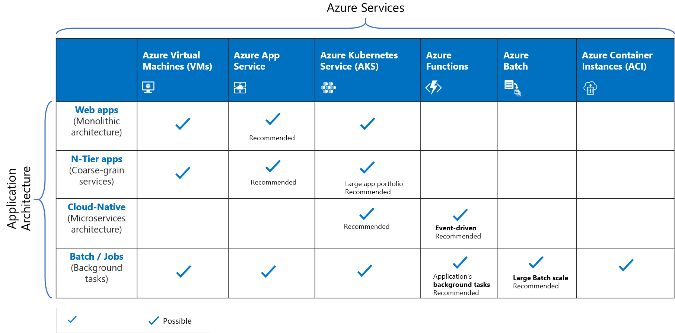
Azure services recommendations for .NET apps
Notes:
As you look to modernize with .NET Core and microservice / serverless / event driven architectures, there are more options and recommendations. Here they are.
Service Sweet spots
Azure App Service Web Apps
Deploy scalable web apps and services for Linux and Windows (with or without using containers)
Azure Container Instances
Run individual containers with no VM management
Azure Kubernetes Service (AKS)
Use leading OSS orchestrator and associated CNCF tools to deploy and manage containers
Azure Batch
Schedule large scale batch processes deployed in containers

Slide 39


Allscripts extends core platform to help health systems stay connected with patients during COVID-19
Read the full story
Allscripts added new features to its .NET based, FollowMyHealth platform for telehealth, appointment confirmation, on-demand messaging and post-care summary services
Launched with Hendrik Health System in Abilene, Texas to help hospitals respond to changing patient needs
New mobile patient experience enabled Hendrik to quickly deploy telehealth services to reduce COVID-19 risk for patients and focus onsite capacity on high-priority admissions.
With Azure App Service and Azure SQL Database, we can now deliver FollowMyHealth solutions and critical new updates, to all our customers quickly and reliably – with no disruptive downtime.
- Chuck Rice, Software Dev Manager, Allscripts
Notes:
Let’s take a look at how Stackify is benefitting from building SaaS apps on Azure.
Stackify wanted to develop applications as a SaaS platform that would make it easy to onboard new customers and scale to accommodate growth. Building a SaaS solution also enables Stackify to gather deep insights into customer behavior, which helps the Stackify team to be agile and make product decisions based on real data.
They chose Azure, because of its deep, rich breadth of easy-to-manage platform-as-a-service (PaaS) solutions that complement the philosophy Stackify was built upon: enabling developers to focus on development. Azure was easy for his team to learn and use because it supports the .NET framework that the Stackify developers were already familiar with. Azure SQL Database elastic pools support its multitenant applications and provides the scalability and cost efficiency Stackify required.
Building their apps on Azure allows Stackify to:
Innovate faster
Rapidly scale to meet demand
Simplify management
Ensure healthy margins and support growth into the future
<click>

Slide 40


Azure lets Stackify easily empower fellow developers
Read the full story
Built multi-tenant SaaS apps on Azure’s fully-managed app and database services
Experienced familiar .NET framework support and SQL Server compatibility for unparalleled developer and DBA productivity
Azure offers scalability, reliability and extensive pre-built functionality for adding new customer experiences and improve efficiencies
“Building our application on Azure has made it really easy to leverage the latest technologies like microservices to innovate faster. We’re also able to scale out to meet our customers where they are, manage thousands of customer databases as one, and protect our customer’s data. With Azure, we can ensure our margins are healthy and grow our business without a hitch.”
-Matt Watson, Founder and CEO
Notes:
Let’s take a look at how Stackify is benefitting from building SaaS apps on Azure.
Stackify wanted to develop applications as a SaaS platform that would make it easy to onboard new customers and scale to accommodate growth. Building a SaaS solution also enables Stackify to gather deep insights into customer behavior, which helps the Stackify team to be agile and make product decisions based on real data.
They chose Azure, because of its deep, rich breadth of easy-to-manage platform-as-a-service (PaaS) solutions that complement the philosophy Stackify was built upon: enabling developers to focus on development. Azure was easy for his team to learn and use because it supports the .NET framework that the Stackify developers were already familiar with. Azure SQL Database elastic pools support its multitenant applications and provides the scalability and cost efficiency Stackify required.
Building their apps on Azure allows Stackify to:
Innovate faster
Rapidly scale to meet demand
Simplify management
Ensure healthy margins and support growth into the future
<click>

Slide 41


Chipotle builds new website with .NET, VS Code and Azure
Read the full story
Built new web presence to replace and unify its self-hosted legacy app
Integrates with the existing content management system and back-end services
Azure offers scalability, reliability and extensive pre-built functionality while Visual Studio provides .NET developers unparalleled productivity
“Our move to .NET Core, Visual Studio Code, TypeScript, and Azure services worked out just like we had planned. Our new website makes us much more agile in supporting Chipotle’s primary mission: bringing people responsibly sourced, classically cooked, real food, with wholesome ingredients.”
—Mike Smith, Lead Software Developer
Notes:
Let’s take a look at how Chipotle is benefitting from a new website on Azure.
Chipotle wanted to build a new web presence to replace and unify its self-hosted legacy website
After deciding upon .NET Core as their dev platform and a complementary tool set. The team built a single-page app that integrates with the company’s existing content management system and back-end services.
Thanks to Chipotle’s choice of platform and tool set for its new web presence, Smith’s team met all functional requirements within the required timeframe and are enjoying benefits including:
Superior developer productivity
Extensive prebuilt functionality
Built-in scalability and reliability
<click>

Slide 42


Episerver migrates Digital Experience Platform to Azure
Read the full story
Episerver helps hundreds of brands deliver engaging online experiences
They now build global e-commerce sites for retailers like NA-KD that need to handle up to 5 orders per second at peak using App Service and Azure SQL DB
With Azure, can now rapidly evolve its platform to respond to ever changing customer needs
“We’ve seen a dramatic boost in our time to value. We’ve developed and released more than 50 upgrades in the last year, giving our customers a huge advantage in quickly launching new digital experiences.
— Nate Barad: Sr. Director of Product Marketing, Episerver
Notes:
Let’s take a look at how Chipotle is benefitting from a new website on Azure.
Chipotle wanted to build a new web presence to replace and unify its self-hosted legacy website
After deciding upon .NET Core as their dev platform and a complementary tool set. The team built a single-page app that integrates with the company’s existing content management system and back-end services.
Thanks to Chipotle’s choice of platform and tool set for its new web presence, Smith’s team met all functional requirements within the required timeframe and are enjoying benefits including:
Superior developer productivity
Extensive prebuilt functionality
Built-in scalability and reliability
<click>

Slide 43


East West Bank builds a modern platform on Azure to win new mobile customers
Read the full story
Needed to build cloud-native digital banking solution to meet unique needs of its international customer base.
Quickly built and deployed a mobile banking experience centered on exceptional experience for low-friction checking accounts.
Onboarded hundreds of thousands of customers differentiating through high availability with “millisecond response times”.
The Azure stack, with its analytics, application servers, API engine, data capabilities, and fraud detection, was the fastest way to kick-start the whole process. In addition, Azure could operate seamlessly in China, just in case we needed some level of edge caching.”
- Rakesh Nambier, Chief Digital Officer, EastWest Bank
Notes:
Let’s take a look at how Stackify is benefitting from building SaaS apps on Azure.
Stackify wanted to develop applications as a SaaS platform that would make it easy to onboard new customers and scale to accommodate growth. Building a SaaS solution also enables Stackify to gather deep insights into customer behavior, which helps the Stackify team to be agile and make product decisions based on real data.
They chose Azure, because of its deep, rich breadth of easy-to-manage platform-as-a-service (PaaS) solutions that complement the philosophy Stackify was built upon: enabling developers to focus on development. Azure was easy for his team to learn and use because it supports the .NET framework that the Stackify developers were already familiar with. Azure SQL Database elastic pools support its multitenant applications and provides the scalability and cost efficiency Stackify required.
Building their apps on Azure allows Stackify to:
Innovate faster
Rapidly scale to meet demand
Simplify management
Ensure healthy margins and support growth into the future
<click>

Slide 44
Additional flexibility with Windows Container

Slide 45
What is a container?
Containers
Containers
VM
VM
App1
App2
App1
App1
Binaries & libraries
Binaries & libraries
Binaries & libraries
Binaries & libraries
Guest OS
Guest OS
Virtual machines
Containers
Virtualize the hardware
Virtualize the operating system
VMs as units of scaling
Applications as units of scaling

Slide 46
Traditional virtualized environment
From dev to production agility across development and operations teams
Virtual machine
Virtual machine
Low utilization of resources
Containerization of applications and their dependencies for portability
Container
Container
Container
Container
App
App
Hypervisor
Host OS
Hardware

Slide 47
Advantages of a containerized environment
Containers are lighter weight and faster to scale dynamically
Virtual machine
Virtual machine
Migrate containers and their dependencies to underutilized VMs for improved density and isolation
Container
Container
Decommission unused resources for efficiency gains and cost savings
Container
Container
App
Hypervisor
Docker Engine
Host OS
Hardware

Slide 48
The benefits of using containers
Agility
+
Ship apps faster
Portability
+
Easily move workloads
Density
+
Achieve resource efficiency
Rapid scale
+
Scale easily to meet demand

Slide 49
Containerized applications
By 2022
75
>
%
of global organizations will be running containerized applications in production¹
¹Gartner.
Notes:
Full statistic sources
Gartner. “6 Best Practices for Creating a Container Platform Strategy.” April 23, 2019. https://www.gartner.com/smarterwithgartner/6-best-practices-for-creating-a-container-platform-strategy/

Slide 50

Azure Kubernetes Service (AKS) support for Windows Server Containers
Now you can get the best of managed Kubernetes for all your workloads whether they’re in Windows, Linux, or both
Lift and shift Windows applications to run on AKS
Seamlessly manage Windows and Linux applications through a single unified API
Mix Windows and Linux applications in the same Kubernetes cluster—with consistent monitoring experience and deployment pipelines

Slide 51
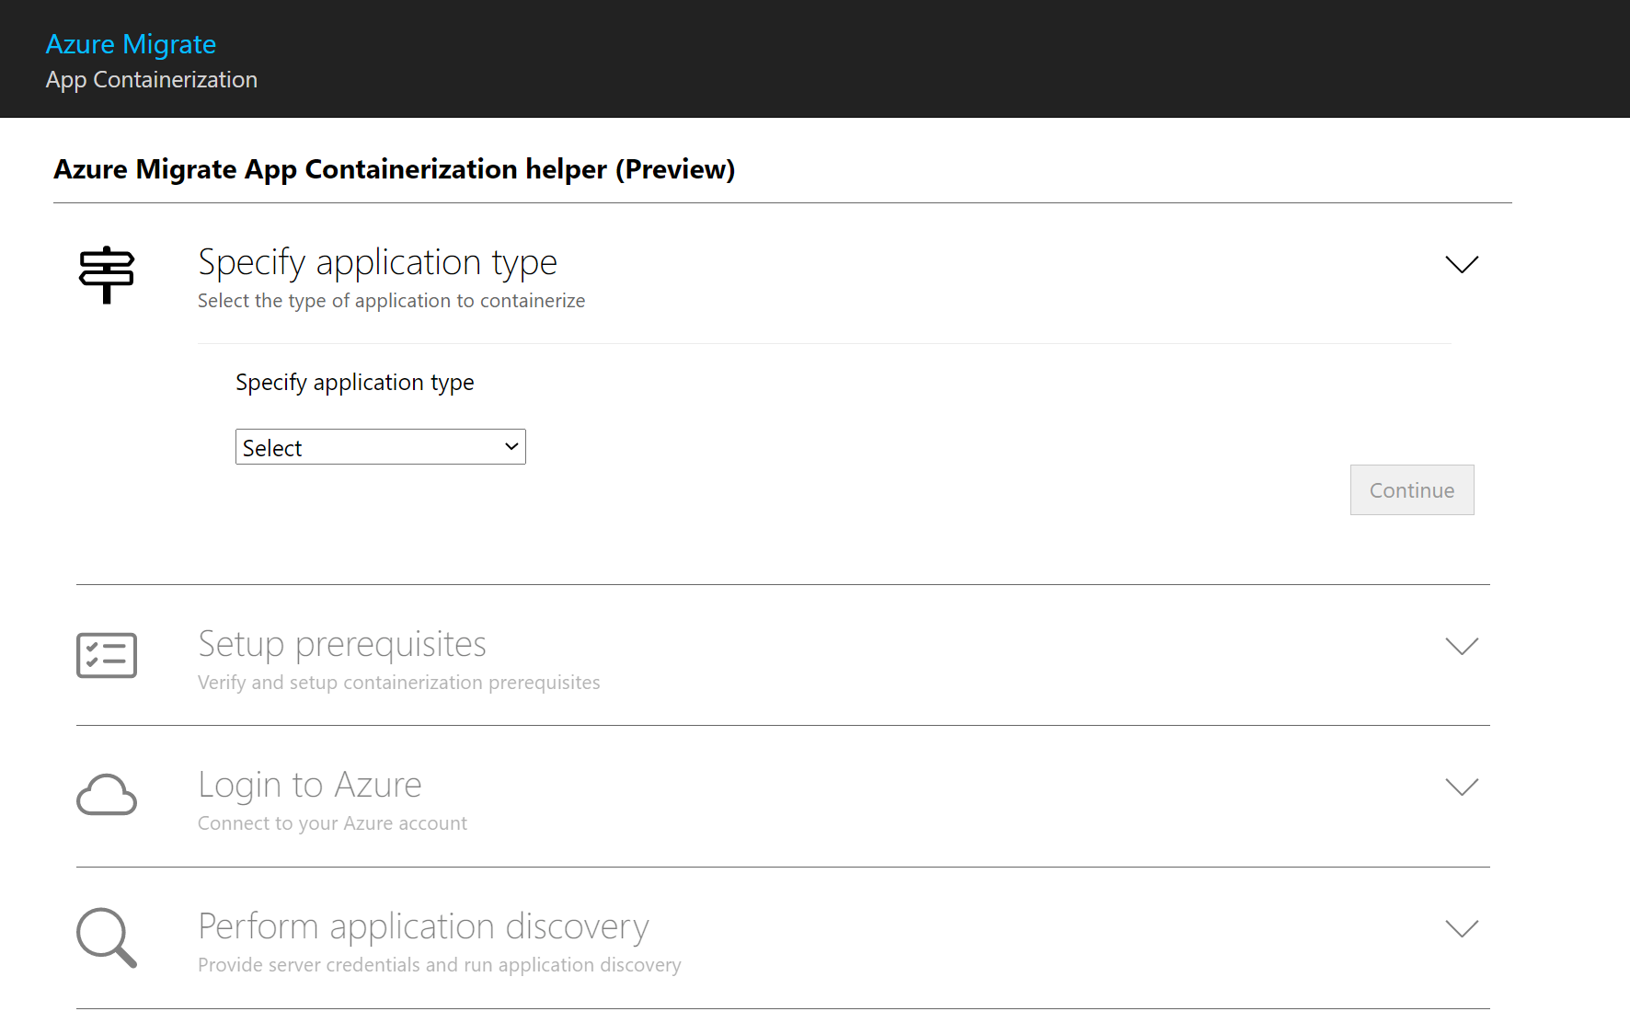
Azure Migrate: App Containerization Tool
PREVIEW
Easiest way to containerize ASP.NET web apps
Discover apps on creates Dockerfile to build application container image
Pushes image to Azure Container Registry & deploy to Windows Containers on AKS
Learn more |
aka.ms/aspnet_appcontainerization
Notes:
To help developers upgrade, we’re building the .NET Upgrade Assistant that helps you modernize older .NET codebases. It's a command line tool that gives you step-by-step instructions for upgrading to the latest versions of .NET.
Analyze NuGet packages and understand where your dependencies are.
It gives you recommendations and fixes for project files, configuration, and source code to help you incrementally upgrade at your own pace.
Multiple project types are supported including ASP.NET MVC web apps, Windows Forms and WPF desktop apps, and Console apps & libraries.
Additional project types like ASP.NET WebForms are coming later.
The .NET Upgrade Assistant is in preview and accepting feedback. We’re targeting release for .NET 6 in November.
Currently it’s being used by Optimizely (Episerver) to move their large, mission-critical applications to .NET 5.
And it’s extensible. Their architects have added recommendations and code templates that apply to their systems that their developers can follow.

Slide 52
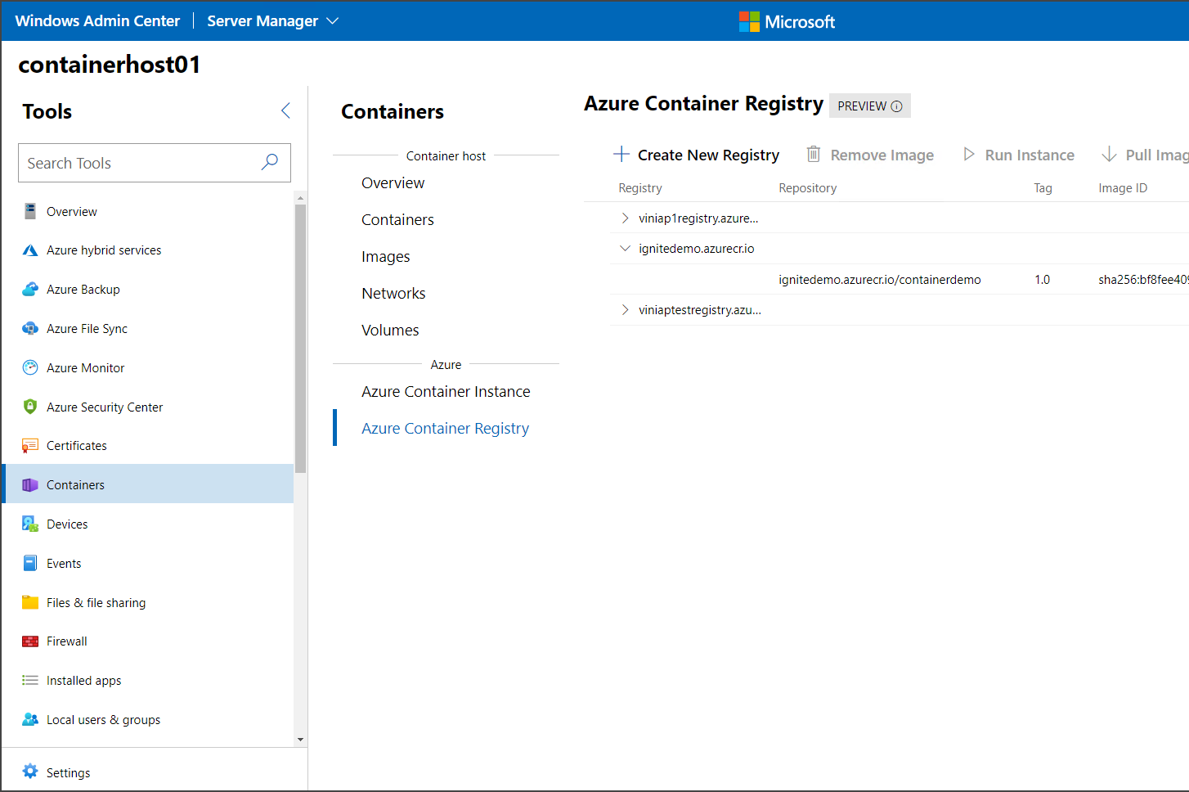
Windows Admin Center Container Tool
PREVIEW
Manage Azure Container Registry using Windows Admin Center
List, create and remove registries and images,
Supports Web Deploy exported ZIP files
Learn more |
aka.ms/wac_container
Notes:
To help developers upgrade, we’re building the .NET Upgrade Assistant that helps you modernize older .NET codebases. It's a command line tool that gives you step-by-step instructions for upgrading to the latest versions of .NET.
Analyze NuGet packages and understand where your dependencies are.
It gives you recommendations and fixes for project files, configuration, and source code to help you incrementally upgrade at your own pace.
Multiple project types are supported including ASP.NET MVC web apps, Windows Forms and WPF desktop apps, and Console apps & libraries.
Additional project types like ASP.NET WebForms are coming later.
The .NET Upgrade Assistant is in preview and accepting feedback. We’re targeting release for .NET 6 in November.
Currently it’s being used by Optimizely (Episerver) to move their large, mission-critical applications to .NET 5.
And it’s extensible. Their architects have added recommendations and code templates that apply to their systems that their developers can follow.

Slide 53
An end-to-end web hosting platform frees up your teams to focus on what matters
Azure Migrate performs detailed assessment of application and database readiness including preferred hosting options in Azure and relevant pricing details
Run applications with confidence letting Azure handle auto-patching for database, OS and runtimes, automated database backup, configurable alerts and logging
Easily add custom domains, SSL certificates, single sign-on (SSO), and identity-service integration to your apps
Reduce regulatory and compliance costs by automating or simplifying over 30% of monitoring work versus on-premises hosted applications
Use your existing .NET and SQL skills and experience to modernize or develop new apps on Azure SQL Database and Azure SQL Managed Instance
Use GitHub Actions to automate the testing and deployment of your applications onto App Service’s global infrastructure
Azure manages your apps and data
Built-in intelligence optimizes resources and reduces spend
Get more cloud for less
Back to pillar overview slide
Notes:
Azure Migrate performs detailed assessment of application and database readiness including preferred hosting options in Azure and relevant pricing details
Run applications with confidence letting Azure handle auto-patching for database, OS and runtimes, automated database backup, configurable alerts and logging.
Easily add custom domains, SSL certificates, single sign-on (SSO), and identity-service integration to your apps.
Reduce regulatory and compliance costs by automating or simplifying over 30% of monitoring work versus on-premises hosted applications.
Use your existing .NET and SQL skills and experience to modernize or develop new apps on Azure SQL Database and Azure SQL Managed Instance.
Use GitHub Actions to automate the testing and deployment of your applications onto App Service’s global infrastructure.

Slide 54
Optimize spend with built in intelligence that can sense and surface opportunities to save
Built-in, AI-powered automatic tuning and adaptive query optimization supports peak performance in Azure SQL Database
Break down how increased traffic or upstream dependencies are affecting response times with rich out of the box monitoring for ASP.NET applications in Application Insights
Improve availability, security and performance while reducing costs with personalized recommendations from Azure Advisor
View application resource usage in real time and configure alerts to respond to unexpected conditions with Azure Monitor
Azure manages your apps and data
Built-in intelligence optimizes resources and reduces spend
Get more cloud for less
Back to pillar overview slide
Notes:
Built-in, AI-powered automatic tuning and adaptive query optimization supports peak performance in Azure SQL Database.
Break down how increased traffic or upstream dependencies are affecting response times with rich out of the box monitoring for ASP.NET applications in Application Insights
Improve availability, security and performance while reducing costs with personalized recommendations from Azure Advisor
View application resource usage in real time and configure alerts to respond to unexpected conditions with Azure Monitor

Slide 55
Reduce investments in custom code and third-party plug-ins with a fully managed and extensible platform
Increase developer productivity by 50% using serverless tools like Logic Apps and Functions to integrate your application with any internal and external systems
Eliminate replica staging environments and ship new versions and features with zero downtime using deployment slots
Avoid rprivileges, SQL Server agent jobs and SSIS packages with migration tools available in Azure e-building on-premises objects like SQL and Windows logins, groups and Migrate
Use App Insights to break down how increased traffic or upstream dependencies are affecting response times
Azure manages your apps and data
Built-in intelligence optimizes resources and reduces spend
Get more cloud for less
Back to pillar overview slide
Notes:
Increase developer productivity by 50% using serverless tools like Logic Apps and Functions to integrate your application with any internal and external systems
Eliminate replica staging environments and ship new versions and features with zero downtime using deployment slots
Avoid re- building on-premises objects like SQL and Windows logins, groups and privileges, SQL Server agent jobs and SSIS packages with migration tools available in Azure Migrate
Use App Insights to break down how increased traffic or upstream dependencies are affecting response times

Slide 56
Ensure the underlying infrastructure can scale resources to meet application demand
Power your app on an enterprise grade hosting platform that serves over 2 million sites, processes over 41 billion requests per day and over 9 trillion SQL database queries per day
Build on infrastructure with a 99.95% SLA won’t fail when your customers need it most
Rapidly adapt to changing requirements with auto-scaling SQL Database serverless compute and Hyperscale storage up to 100 TB
Scale your app to meet demand with over 58 regions
Easily scale out underlying VMs to match demand or configure auto-scaling to sense and respond to changing traffic patterns
Right size your app with configurable CPU, memory, disk space and easily add new features like custom domains and certificates with a few clicks
You can use deployment slots to coordinate your QA, staging, and production deployments
Right-size your infrastructure and increase availability
Get up to speed quickly on a platform tailored for .NET
Secure your application and databases
Back to pillar overview slide
Notes:
Power your app on an enterprise grade hosting platform that serves over 2 million sites, processes over 41 billion requests per day and over 9 trillion SQL database queries per day.
Build on infrastructure with a 99.95% SLA won’t fail when your customers need it most
Rapidly adapt to changing requirements with auto-scaling SQL Database serverless compute and Hyperscale storage up to 100 TB.
Scale your app to meet demand with over 58 regions
Easily scale out underlying VMs to match demand or configure auto-scaling to sense and respond to changing traffic patterns
Right size your app with configurable CPU, memory, disk space and easily add new features like custom domains and certificates with a few clicks
You can use deployment slots to coordinate your QA, staging, and production deployments.

Slide 57
Get up to speed quickly on a platform tailored for .NET
Build on managed infrastructure and database offerings that are purpose built for (.NET) web hosting
Native integration with IIS offers familiar runtime experience from day one
Access familiar logging sources like Application Event Logs and log/trace information emitted via System. Diagnostics with built-in logging capabilities
URL Rewrite is pre-installed for devs to define custom rules in web.config
ASP.NET apps relying on InProc session state can ensure HTTP sessions are always routed back to the same server using App Service’s support sticky sessions
Run non-interactive utility code or console worker apps alongside ASP.NET apps with WebJobs
Quickly connect to Azure SQL Database with .NET and Visual Studio and query data with Transact-SQL statements you’re familiar with
Seamlessly build against a managed SQL offering that shares a common code base with SQL Server and uses identical SQL language, query processing, management features and tools
Right-size your infrastructure and increase availability
Get up to speed quickly on a platform tailored for .NET
Secure your application and databases
Back to pillar overview slide
Notes:
Build on managed infrastructure and database offerings that are purpose built for (.NET) web hosting.
Native integration with IIS offers familiar runtime experience from day one.
Access familiar logging sources like Application Event Logs and log/trace information emitted via System. Diagnostics with built-in logging capabilities
URL Rewrite is pre-installed for devs to define custom rules in web.config
ASP.NET apps relying on InProc session state can ensure HTTP sessions are always routed back to the same server using App Service’s support sticky sessions.
Run non-interactive utility code or console worker apps alongside ASP.NET apps with WebJobs
Quickly connect to Azure SQL Database with .NET Core and .NET with Visual Studio and query data with Transact-SQL statements you’re familiar with.
Seamlessly build against a managed SQL offering that shares a common code base with SQL Server and uses identical SQL language, query processing, management features and tools.

Slide 58
Secure your application and improve performance
React to traffic loads with Azure Autoscale and perform traffic routing and load-balancing through Azure Front Door
Reduce latency by placing your content assets closer to your customers, with Azure Content Delivery Network
Protect your applications with Azure Web Application Firewall, Azure Firewall, and Application Gateway
Improve your security posture and threat protection with Azure Security Center and extensive compliance certifications
Intelligent threat detection and proactive vulnerability assessment alert and remediate potential threats to the database
Layers of security with the broadest range of built-in security controls across T-SQL, authentication, networking and key management
Most comprehensive compliance coverage (90+ offerings) of any cloud database service
Right-size your infrastructure and increase availability
Get up to speed quickly on a platform tailored for .NET
Secure your application and databases
Back to pillar overview slide
Notes:
React to traffic loads with Azure Autoscale and perform traffic routing and load-balancing through Azure Front Door.
Reduce latency by placing your content assets closer to your customers, with Azure Content Delivery Network.
Protect your applications with Azure Web Application Firewall, Azure Firewall, and Application Gateway.
Improve your security posture and threat protection with Azure Security Center and extensive compliance certifications.
Intelligent threat detection and proactive vulnerability assessment alert and remediate potential threats to the database.
Layers of security with the broadest range of built-in security controls across T-SQL, authentication, networking and key management.
Most comprehensive compliance coverage (90+ offerings) of any cloud database service.

Slide 59
Unparalleled developer productivity means you can ship new features faster and maximize value per dev cycle
Make and ship changes faster with native integration with Visual Studio, GitHub and App Service
Seamless remote and live-site debugging for ASP.NET apps lets you diagnose issues and production environments and resolve quickly, without impacting traffic
Create custom automated workflows to build, test, package, release and deploy to Azure following a push or pull request, using GitHub Actions
Build end-to-end Continuous Integration/Continuous Deployment (CI/CD) capabilities directly in the repository
Publish code updates directly to App Service with VS and VS Code integration
Ensure governance from anywhere by using Azure Policy to maintain visibility into whether your codebase or services are compromised
Stand up critical capabilities
Extend applications to interact with any system and evolve quickly
Innovate with confidence
Back to pillar overview slide
Notes:
Make and ship changes faster with native integration with Visual Studio, GitHub and App Service
Seamless remote and live-site debugging for ASP.NET apps lets you diagnose issues and production environments and resolve quickly, without impacting traffic.
Create custom automated workflows to build, test, package, release and deploy to Azure following a push or pull request, using GitHub Actions
Build end-to-end Continuous Integration/Continuous Deployment (CI/CD) capabilities directly in the repository
Publish code updates directly to App Service with VS and VS Code integration
Ensure governance from anywhere by using Azure Policy to maintain visibility into whether your codebase or services are compromised

Slide 60
Add new modalities and connect your app to the data and systems it needs to serve users
Easily connect to new data sources and bring insights from other apps and systems with hundreds of pre-built Logic Apps
Automatically turn legacy web services into modern REST-based APIs by creating façades for your back-end services
Connect on-premises APIs to cloud services with API Management Optimize your website for mobile to reach more customers and reduce site search time with interactive bots
Stand up critical capabilities
Extend applications to interact with any system and evolve quickly
Innovate with confidence
Back to pillar overview slide
Notes:
Easily connect to new data sources and bring insights from other apps and systems with hundreds of pre-built Logic Apps
Automatically turn legacy web services into modern REST-based APIs by creating façades for your back-end services.
Connect on-premises APIs to cloud services with API Management
Optimize your website for mobile to reach more customers and reduce site search time with interactive bots.

Slide 61
Innovate with confidence on a secure and trusted cloud platform
Built-in web app security controls for network, data, identity and logging allows you to scale without worrying about breaching customer confidence
Empower partners and employees to securely access web apps and data while working remote using Azure AD B2B
Increase website security Azure AD multi-factor authentication
Store secrets and credentials with no changes to .NET code
Securely expand sign-in options for end customers, including services like Facebook, Google and others for using Azure AD B2C
Maintain customer trust thanks to $1bn+ Azure has made in investments for security R&D and 3,500 cyber security experts
Stand up critical capabilities
Extend applications to interact with any system and evolve quickly
Innovate with confidence
Back to pillar overview slide
Notes:
Built-in web app security controls for network, data, identity and logging allows you to scale without worrying about breaching customer confidence.
Empower partners and employees to securely access web apps and data while working remote using Azure AD B2B
Increase website security Azure AD multi-factor authentication
Store secrets and credentials with no changes to .NET code
Securely expand sign-in options for end customers, including services like Facebook, Google and others for using Azure AD B2C.
Maintain customer trust thanks to $1bn+ Azure has made in investments for security R&D and 3,500 cyber security experts

